Slide 1
Combatting Climate Change Through Policy
Mishu Pham-Whipple
Notes:
Combatting Climate Change Through Policy
-Mishu Pham-Whipple

Slide 2
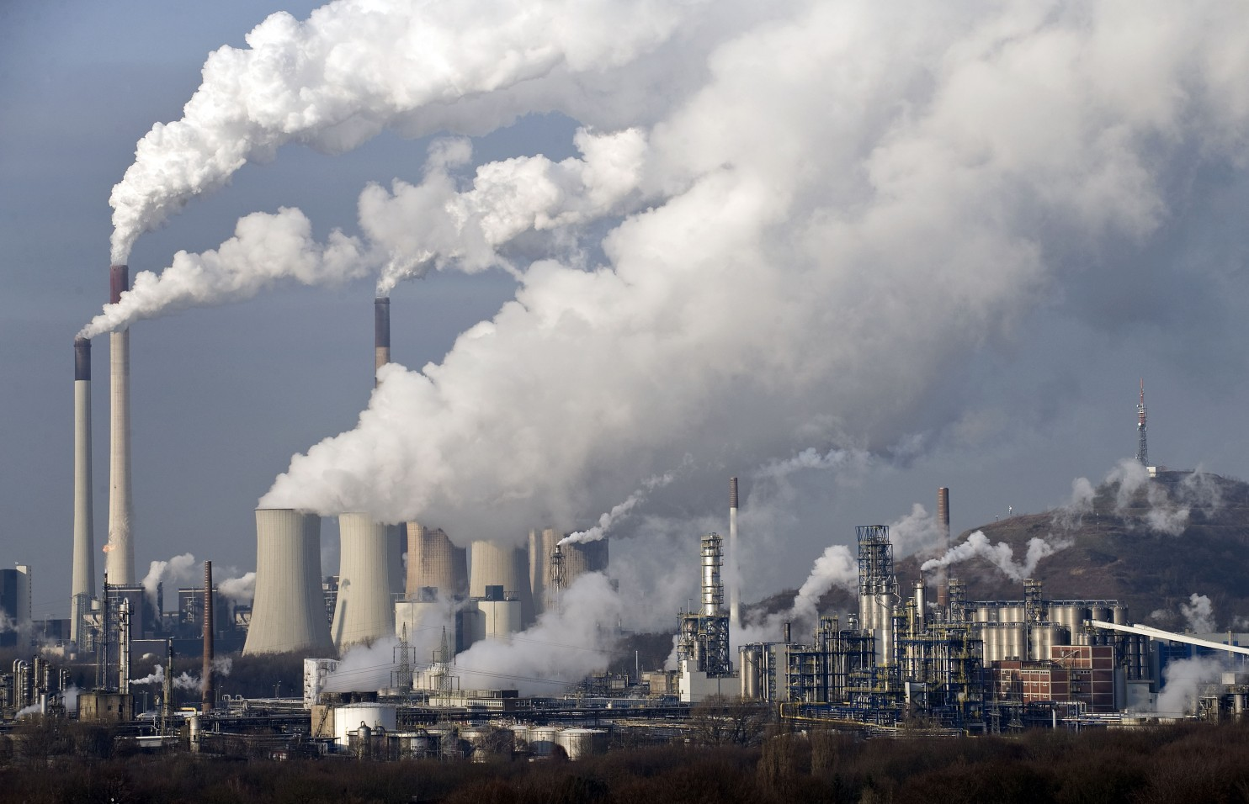
The Age of the Anthropocene
Human activities
Industrialization
Energy
Coal and Oil
Consumption
Greenhouse gas emissions
Notes:
We have entered the Age of the Anthropocene, an epcoh where human activities have made a significant impact on the Earth, which can be seen by looking at geological, atmospheric, hydrologc and biospheric evidence. This began with the industrial revolution in the late 1700s with the transition from agrarian rural societies to urban industrial manufacturing society. The industrial revolution could not have been possible without coal as an energy source. Oil was later incorporated as an energy source of industrial society.
Today we know that these energy sources emit carbon dioxide and other greenhouse gases and have cascading effects on the physical and biological environment. However, the effects of using these energy sources was not immediately known at the time. The nations that industrialized and are in the process of industrializing built their economy and entire society around these energy sources.

Slide 3
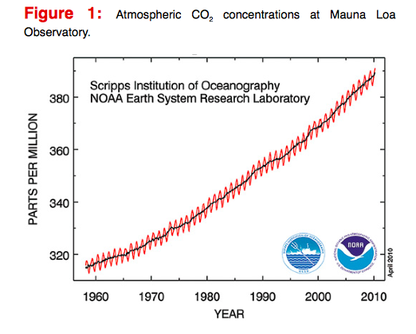
The Science of Climate Change
Observations:
Atmosphere:
Temperature
CO2 levels
Precipitation
Oceans:
Temperature
pH – acidity level
Arctic Ice:
Ice coverage
Biodiversity:
Species’ range and population
Notes:
As scientists collect more and more data on the atmosphere, ocean, arctic ice, and biodiversity, their concern over the patterns they see is growing. Their data, put in a historical context, suggests that these observed changes coincide with the industrial activity and associated greenhouse gas emissions. Carbon dioxide emissions continue to grow every year (Anonymous). There is consensus among the scientific community that climate change from human activity is real and has serious implications for the physical and biological environment.
Although the effects of climate change can not be precisely determined, due to varying models of future carbon emissions, there is also consensus about the cause of climate change, which is greenhouse gas emissions from human activity (Solomon 2009)
The graph shows atmospheric carbon dioxide levels over time and is used in a Word Bank report:
The World Bank. Turn Down the Heat: Why a 4 Degree Warmer World Must be Avoided. 2012.

Slide 4
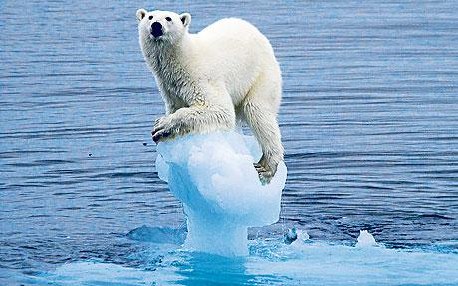
Implications
Ecosystems
Extinction of species
Range changes
Invasive species
Humans
Spread of infectious diseases (ie. Malaria, dengue fever)
Water and food scarcity
Loss of ecosystem services (ie. Fisheries)
Notes:
Climate change threatens the natural environment and humans. Because of the services that the natural environment provides to humans, threats to the natural environment are indirect threats to humans as well. Heat waves, severe drought, and major floods in many regions, are expected to worsen, seriously impacting ecosystems and associated services.
The shift in climate also threatens to shift the ranges of species, bring species to extinction, and make it more possible for invasive species to infiltrate ecosystems (Bellerd 2012). A decrease genetic diversity of populations due to directional selection and rapid migration could in turn affect ecosystem functioning and resilience (Jenouvrier 2013). The expanding range of mosquitos threatens to spread infectious diseases (Martens 2001). Droughts and floods will disrupt the agricultural system and reduce water availability (Stephenson 2013).
Many argue that climate change is the biggest issue that our society faces today.

Slide 5
Solutions
Reduce Greenhouse Gas Emissions!!
Personal lifestyle choices
Energy sources
Government investment
Notes:
The solutions lies in the heart of the problem: greenhouse gas emissions (Bohannon). Emissions need to be reduced from a personal to global level. Every consumer decision can be tied to greenhouse gas emissions with the embodied energy that it took to bring that product or service to you. There are countless direct and indirect strategies to reduce greenhouse gas emissions. Examples of direct ones are not using gas powered transportation, reversing deforestation, and switching energy sources from fossil fuels to renewable energy sources such as wind and solar. An example of an indirect solution is buying local so less energy is used to transport goods.
Although everyone can do their part on an individual level by changing their lifestyle to have smaller carbon footprints, these changes will not have as much of an impact if they are working within a system where infrastructure and institutions are still modeled on the fossil fuel system. This is where government on all levels need to play a role and make structural changes to reduce carbon emissions.

Slide 6
A Policy: I-732 WA State Carbon Tax
Taxes fossil fuels in and entering WA
$25 per metric ton of carbon w/ gradual annual increase
Revenue neutral
Cuts sales tax, funds a rebate for low income families, cuts B&O tax
Encourages investment in renewable energy
Notes:
One policy that has been proposed to combat climate change by reducing carbon emissions is Washington Initiative 732 – the Washington State Carbon Tax.
The goal of the policy is to encourage cleaner energy solutions by shifting the tax burden onto carbon pollution and away from regressive and burdensome taxes that hurt families and small businesses (Carbon WA). It does this by putting a price on carbon, making fossil fuel companies pay for their pollution. Fossil fuel companies are CURRENTLY ALLOWED TO POLLUTE FOR FREE. People are afraid of the thought of paying more taxes but the policy is revenue neutral, meaning that consumers won’t be paying more taxes because other taxes will get cuts. The tax swap will reduce the state’s sales tax and B&O tax, as well as fund the Working Families Rebate for low income families.
The policy has yet to be enacted. The grassroots organization Carbon Washington organized the collecting of 363,126 signatures for I-732 that were then certified by the Secretary of State last month. The measure will now go to the state legislator for consideration, where lawmakers can either pass the policy of send it to the fall statewide ballot this year (From Our Corner).

Slide 7
Public Opinion: Against
The Opposition:
Consumers
Republicans in general
Some environmentalists
It would make gas and electricity prices go up”
“It would hurt the economy”
“It hurts communities of color”
“The revenue should be invested directly into renewable energy”
“It is not politically feasible (so why bother)”
Notes:
A concern that many citizens immediately have is that it will make gas and electricity prices go up (Schiermeier).
Republicans or those who believe that the market, particularly the fossil fuel market, should be unregulated to maintain economic growth (Washington).
There is also concern over how the revenue produced will be used or distributed (Gevrek).
While environmentalists and beyond agree that the state needs to take serious action on climate, they disagree on the best approach, which is why an alliance of the state’s major green and labor groups have tried to squash the efforts of Carbon Washington, the team behind the grassroots I-732 campaign. The alliance against the initiative say that the policy is insensitive to communities of color, the revenue produced should be invested into clean energy investments, schools and other community programs, and that it is not politically feasible against the fossil fuel industry (Carbon-tax).

Slide 8
Public Opinion: Supporting
“It will encourage investment in energy efficiency and renewable energy”
“It will put money back into the pockets of families, consumers, and businesses”
“It fixes our disproportionate tax system”
“It will reduce carbon emissions”
“There is already a successful example: British Columbia’s carbon tax!”
“It will send a message and raise awareness”
The Supporters:
Environmentalists
Economists
Young Voters
Democrats
Republicans
Notes:
Because Washington state has no income tax and instead relies heavily on sales tax for revenue, the state’s current tax system affects low income families disproportionately. The revenue neutral nature of the policy combats this by putting money back into the pockets of consumers and the Working Families Rebate, which will provide up to $1,500 a year for 400,000 low-income households. The cuts on sales tax and B & O tax (Business & Occupation) also compensate for these increases. The way the revenue is redistributed works to relieve the burden felt by consumers, and low income families, which tend to be communities of color.
Proponents also say that young voters in the 2016 turn out give the proposal a fighting chance and that a carbon tax is much simpler for voters to understand than alternatives like cap and trade. They also point out that the policy draws support from across the political spectrum. Hendrik Wolff, an assistant professor of economics at the University of Washington, whose research includes climate policy, said, “The advantage [of a carbon tax] is that it is easier administratively to implement.”
A higher price on carbon emissions may lead to increased investment in cleaner energy sources such as solar and wind power. In addition to being transparent and simple, a carbon tax can be applied across all major emissions sources of the economy. They are easier for governments to implement compared to other market based instruments as policy makers can rely on the well-established administrative structure of existing taxes. A study estimated that this policy would reduce emissions by 8.4% in one year (Mori).
A carbon tax may curtail international economic competitiveness by adversely affecting the energy intensive firms and industries that compete in an international market. However, environmental regulations often cause firms to be more efficient and competitive in the long run by triggering technological innovation and production efficiency. There is consensus among economists that carbon pricing is the most efficient way to cut emissions (Gevrek).
British Columbia’s carbon tax, which was introduced in 2008 and widely considered by economists is a prime example of a successful carbon pricing system that is very similar to this policy (B.C.)(Harvey).
There is also concern over the environmental effectiveness of the policy. Although none of the revenue goes directly to funding renewable energy investment, the policy disincentives fossil fuels, thereby promoting renewable energy and making that industry more competitive (Fisher). Proponents also say that the policy itself raises public awareness around climate change and fossil fuels, and has cascading effects on environmental consciousness and lifestyle choices.

Slide 9
Conclusions
Public opinion tends to favor the policy
Government action needed
Would reduce carbon emissions
Would encourage investment in renewable energy
Reduce sales tax, business tax (B&O), and fund a rebate for low income families
Notes:
Public Opinion tends to favor the policy but it is up against the powerful fossil fuel industry and a divided environmental voting base. I believe the policy is well designed to combat the common concerns over equality and the economy. We can’t wait any longer to start curbing fossil fuel emissions. If voters decide to pass WA I-732, Washington state would be the first state in the U.S. to implement a carbon tax, making the state a leader in climate change legislation. A carbon tax would be a symbolic step because it would signal recognition that those who use fossil fuels or products do not bear all the costs of their actions (Summers). The Washington state carbon tax would also set an example for other governments to take action.
I actually volunteered to collect signatures for the initiative so I personally think it’s a great policy. I may be biased but my analysis of the policy is not.

